Slide 1
Direct Volume Visualization
Part II

Slide 2
Classification
Direct Volume Visualization II
Lighting
  Shading
  Depth Cueing
  Shadows
  Enhanced effects (global illumination, ambient occlusion, scattering)
Validation
Tools for volume visualization

Slide 3
Recap: Interaction of Light with Surfaces (from Computer Graphics I)
Direct Volume Visualization II
Incidence angle θ: angle between L and N (determines diffuse reflexion)
Reflexion angle r: angle between R and N
Angle Φ between V and R determines intensity of incident light
If V = R (or Φ =0), the light is maximally reflected to the viewer
(Blinn-Phong Lightning Model)
N
r
R
L
θ
V
L-vector for light source
N-surface normal
R-reflected light ray
V-vector to the viewer

Slide 4
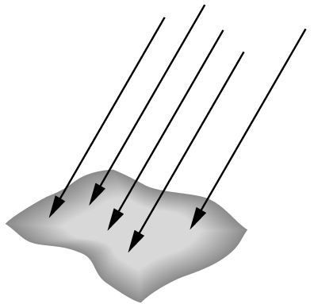
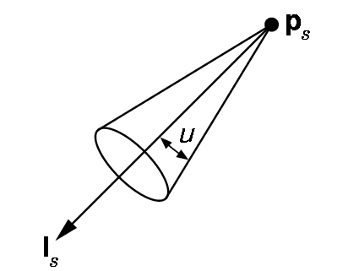
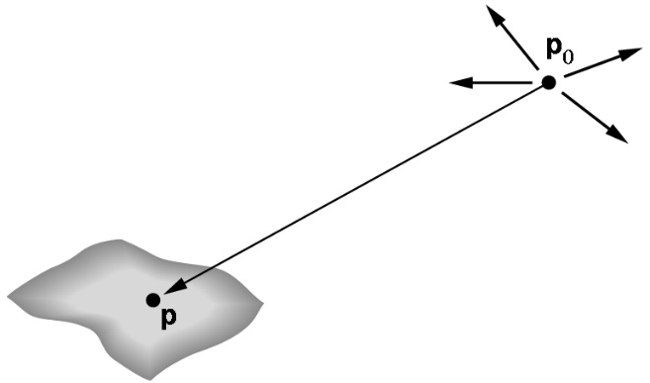
Recap: Light Sources
Position represents
top of the sight cone
Source: Angel (2000)
Point light sources Directed light Spotlight ~ Parallel projection
Calculations
are simplified

Slide 5
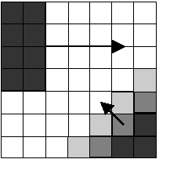
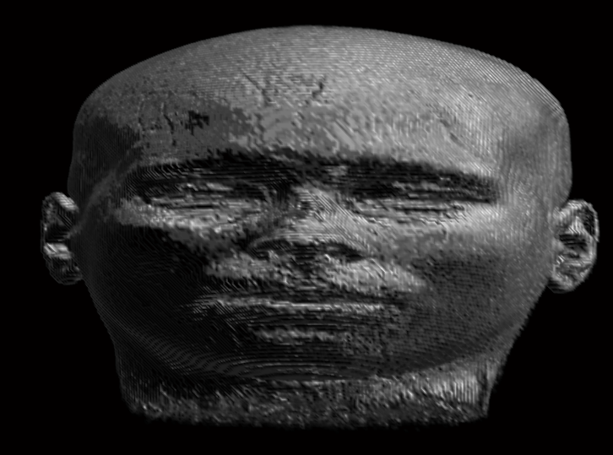
Illumination Effects: Gradient-Based Shading
Approximation of the surface normal through gradient calculation (grey level gradient shading, [Höhne/Bernstein, 1986] )
  Problem: Storage capacity per voxel (e.g. for 16 bit float: 3 * 2 byte), solutions:
    Precision reduction (3 * 8 bit)
    Discretization of the normal in a gradient lookup table
    On-the-fly calculation
Illuminated display of an MRI data set (high sampling rate and trilinear interpolation)
  Problems:
    High sensitivity (consider smoothing of gradients) or ignore small gradients (use the threshold value)
    Strength of the gradient is not considered

Slide 6
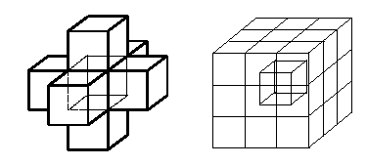
Gradient Estimation
Common gradient estimation schemes (remember Vis-lecture):
  (1) Central differences (6 neighbors):
∂V (X) = (∂ V/ ∂ x, ∂ V/ ∂ y, ∂ V/ ∂ z)
∂ V (x_{i}, y_{j}, z_{k}) = (½ (V(x_{i+1}, y_{j}, z_{k}) – (V(x_{i-1}, y_{j}, z_{k})),
(½ (V(x_{i}, y_{j+1}, z_{k}) – (V(x_{i}, y_{j-1}, z_{k})),
(½ (V(x_{i}, y_{j}, z_{k+1}) – (V(x_{i}, y_{j}, z_{k-1})) )
  (2) Estimation of gradients from the 26 neighbors (weighting according to the distance to the central voxel)
  (3) Gradient calculation not from direct neighbors, but e.g. from x_{i+2}, x_{i-2}, y_{i+2}, y_{i-2}, z_{i+2}, z_{i-2}
The second version is of higher quality, but slower
Problems: Edge treatment, linear structures, artifacts → smooth gradients are required

Slide 7
Gradient Lookup Table
One quadruple from RGBA values is saved per gradient (color/brightness and transparency) in the shading-lookup table.
Accuracy of the normal direction: precise equal distribution of points on the sphere surface for square numbers (64, 81, 121, …)
  For n = 121 → 7 bit for the normal direction and 9 bit for the data
  Currently, such solutions are no longer needed (improved hardware)
Types:
  Light source is relative to the volume → shading-lookup table remains constant during rotations
  Light source remains constant → shading-lookup table must be recalculated in case of rotations (for few 100 indices)
Discussion: Gradient shading models a light source that transmits parallel light (no point light source)

Slide 8
On-The-Fly Gradients
On-the-fly calculation of gradients:
  Central difference (usually 6-neighborhood) is evaluated per sampling point
  Advantage:
    No additional volume storage required
    Better result (quality), since interpolated values are used and the normals are not interpolated (analogous to pre-/post-classification)
  Disadvantage: Frequent memory access

Slide 9
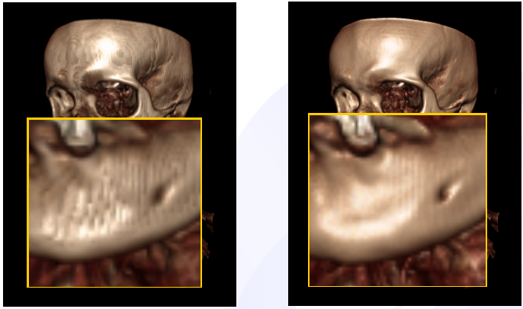
Comparison of Gradients
Comparison of stored gradients (8 bit per scalar) and on-the-fly calculation
[Engel2006]

Slide 10
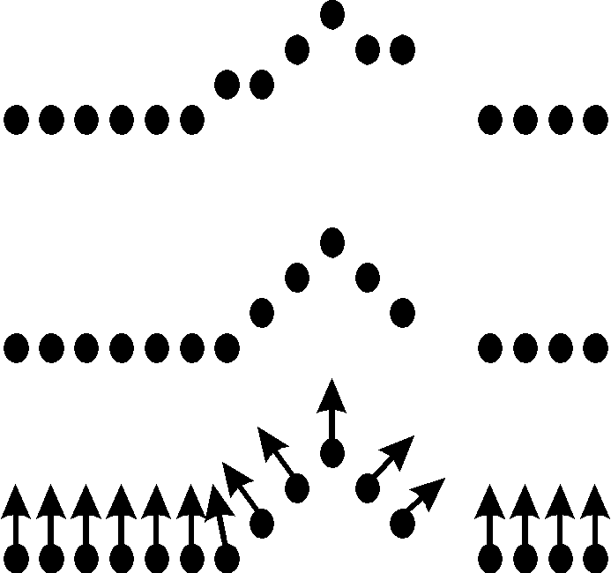
Gradient-Based Shading
Context-sensitive shading (Yagel et al. [1991])
  Data are pre-processed and smoothed
  Only voxels that belong to an object are included in the normal estimation (criterion: continuous curvature transition)

Slide 11
Discussion: Gradient-Based Shading
Gradient-based shading can be combined with:
Multiple point or directional light sources,
All rendering paradigms,
Clipping plane-based exploration
  Surface normal of the clipping plane is used for lightning
Gradient-based shading does not enable
Shadow computation,
Multiple scattering events (global illumination)
(for more discussion, see [Jönsson, 2014])

Slide 12
Illumination Effects
Illumination effects differ in complexity ranging from
Local shading with a point light source,
Local shading with an area light source,
Multiple scattering with a point light source,
Multiple scattering with an area light source, to
Multiple scattering with multiple area light sources.
Area light sources enable soft shadows. Multiple scattering enables refraction and indirect lightning.
Ambient occlusion further enhances realism (Jönsson, 2014).
Notes:
Local shading: only the direct connection is considered (one ray), no refraction, scattering, multiple reflections.
Area light source: often discretized as a number of point light sources

Slide 13
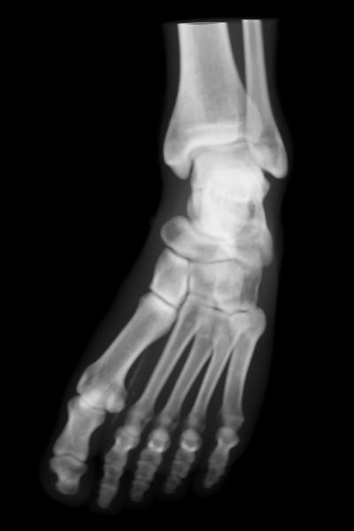
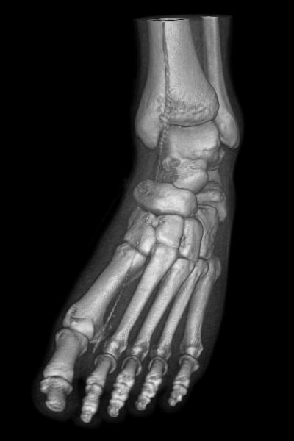
Illumination Effects: Shading
Visualization with and without shading
(Visible Man CT data set, © Schroeder et al. [1998])

Slide 14
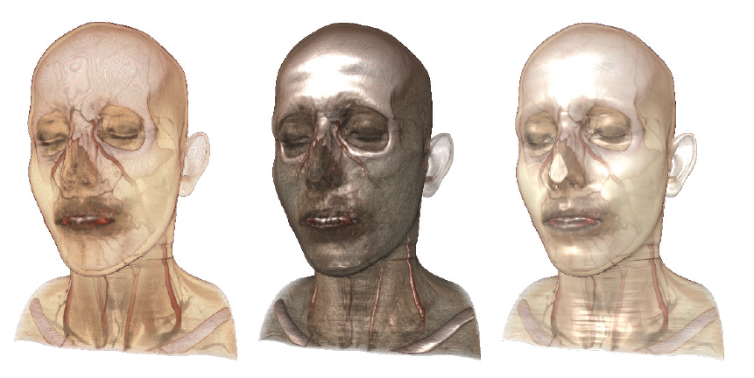
Illumination Effects: Combination
Combination of different illumination and rendering modes
  e.g. DVR with first hit raycasting
    Emission & Absorption, Shaded, Combination of both
[SiggraphCourse2008]
Notes:
first hit raycasting: first voxel with a strong gradient (probably a surface)

Slide 15
Illumination Effects: Depth Cueing
Techniques for simulation of the atmospheric decrease of light, e.g. through homogeneous absorbing fog
Thus, far away structures appear darker
Depth cueing can be used to illustrate depth relations
Naive implementation: distance d is calculated per voxel and color C is diminished by a term T_{fog}(d)

Slide 16
Illumination Effects: Depth Cueing
Standard function for depth cueing:
T_{fog}(d) = T₀e^{-pd}
T₀ and p are user-defined constants.
Implementation:
  Use of a Lookup table for possible values of T_{fog} (indexing with d)

Slide 17
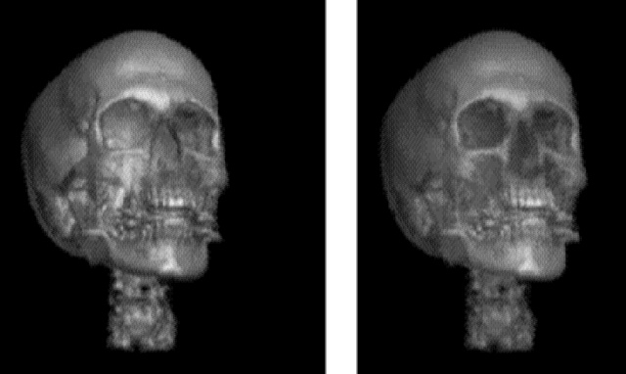
Illumination Effects: Depth Cueing
CT head data set (left without, right with depth cueing) Source: Lacroute [1995], p. 161

Slide 18
Illumination Effects: Shadows
A further possibility to make spatial details more visible
Requires the definition of a light source and an analysis about how the voxels are oriented towards the light source.
Procedure:
  Two-Pass Rendering: 1st pass: calculation of illumination per voxel → storage in shadow buffer. 2nd pass: image generation. (Levoy [1988])
  Disadvantage: Requires a very large 3D shadow buffer.
  Further developments aim to decrease the memory consumption and to increase the performance: Deep Shadow Maps (Kratz [2006]), Adaptive Volumetric Shadow Maps (Salvi [2010])

Slide 19
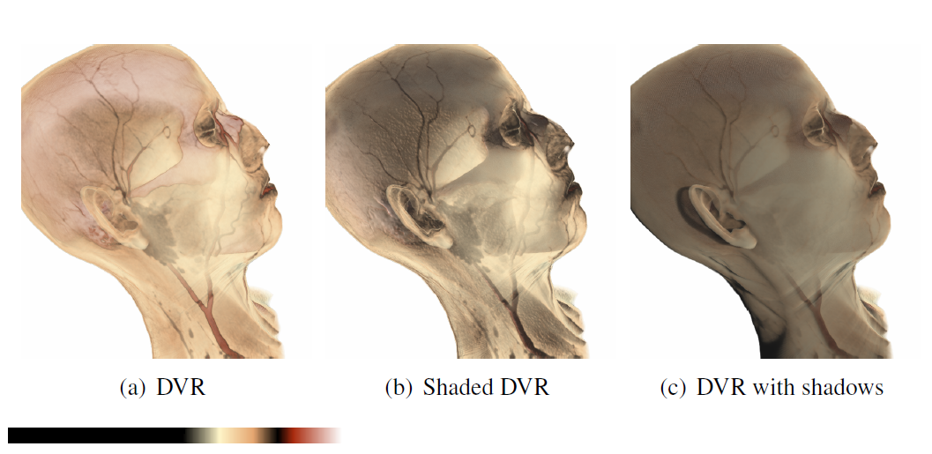
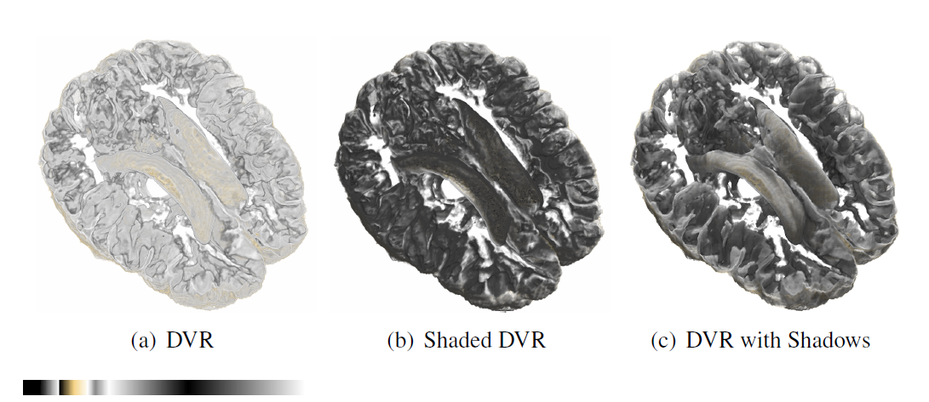
Illumination Effects: Shadows
[Kratz2006]
Notes:
Note the difference between shadows and shading

Slide 20
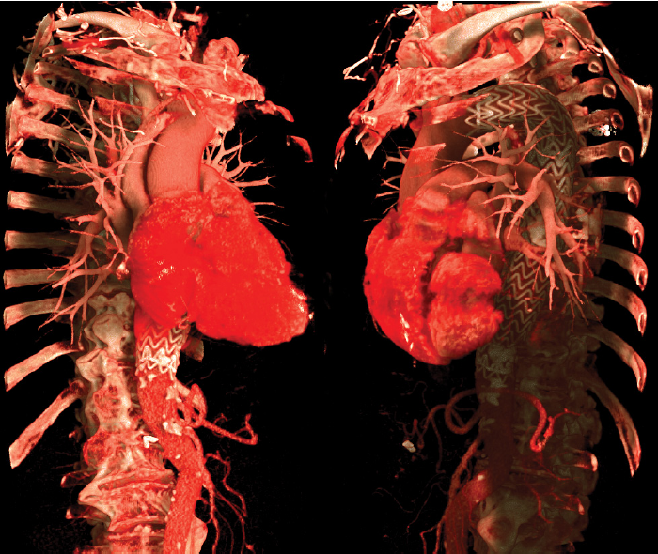
Illumination Effects: Global Illumination
Global effects increase the realism
  Interaction between light and medium (density values) is included; indirect lightning is considered (multiple scattering)
  With precomputed illumination (light sources are fix), it often becomes sufficiently fast (Jönsson, 2014)
[SiggraphCourse2008]

Slide 21
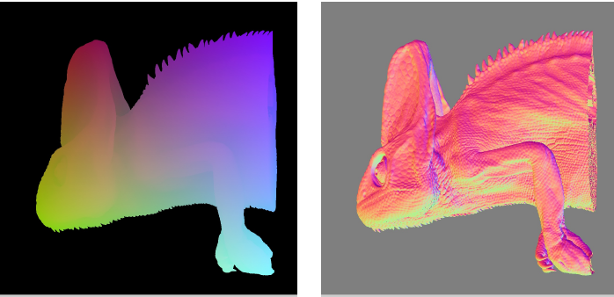
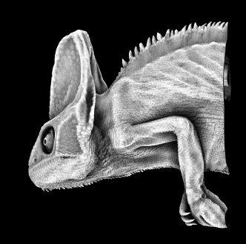
Illumination Effects: Ambient Occlusion
Ambient Occlusion: Self-occlusion
  How much light can reach a certain point? (spherical emission of rays from the point)
  Methods in the object space (volume) or image space (depth buffer) or hybrid approaches are possible

Slide 22
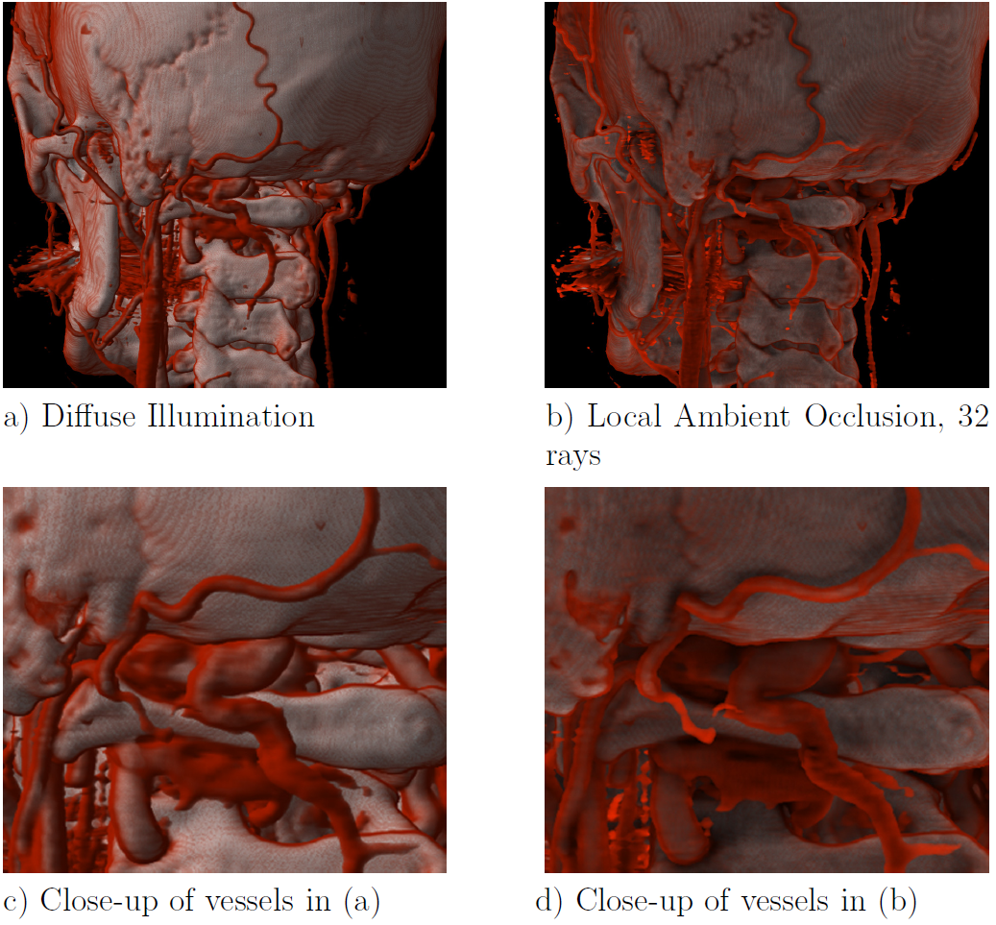
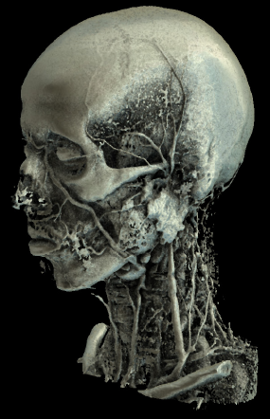
Illumination Effects: Ambient Occlusion
[SiggraphCourse2008]

Slide 23
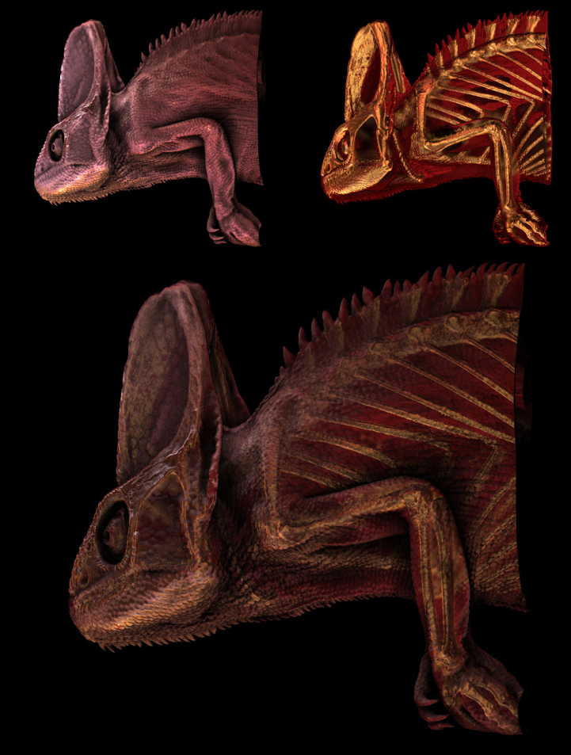
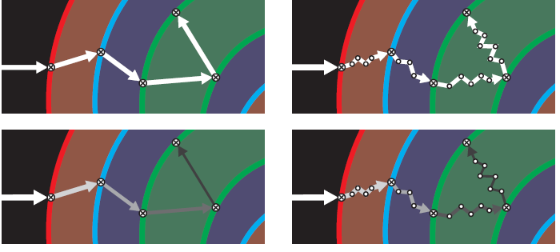
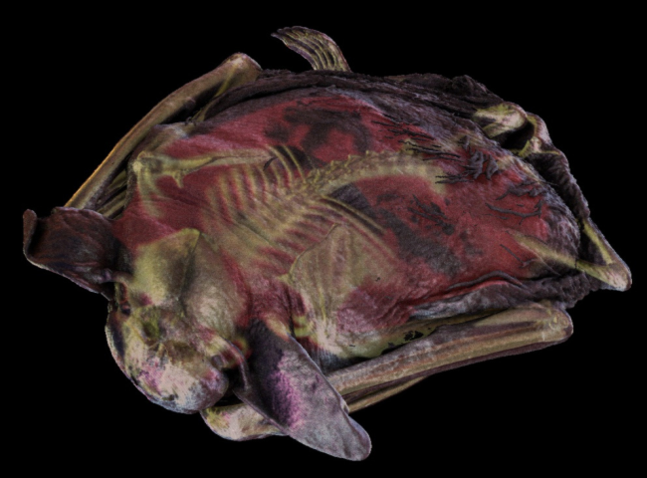
Illumination Effects: Scattering
Light rays are distracted by the medium
  Ray scattering
[SiggraphCourse2008]

Slide 24
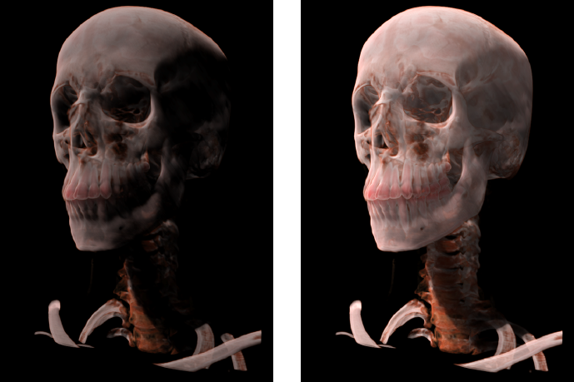
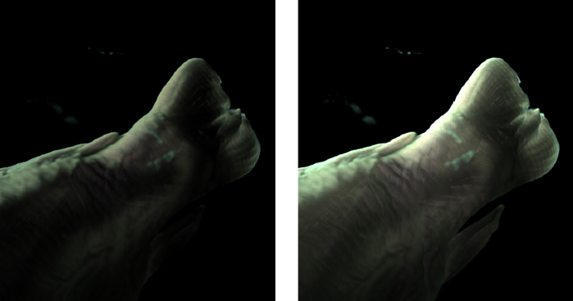
Illumination Effects: Scattering
Indirect lightning (multiple scattering)
[SiggraphCourse2008]
Notes:
In traditional computer graphics, indirect lightning is often performed by means of lightning computations.

Slide 25
Illumination Effects
Illumination effects can be integrated in DVR procedures and enhance the perception of spatial structures.
Many enhanced effects are possible; usually hardly relevant in clinical practice and still at the expense of interactivity.
Gradients are locally approximated. The associated quality reduction is hardly perceivable.

Slide 26
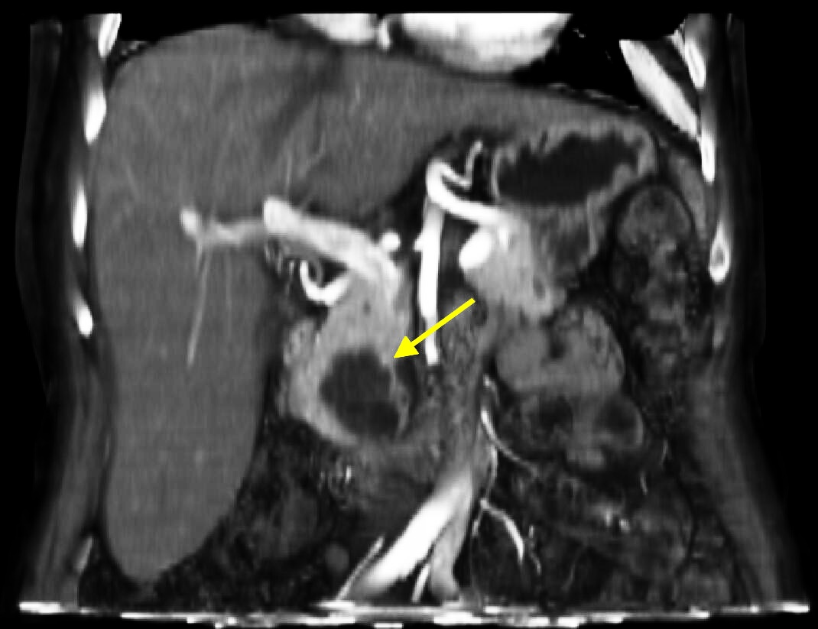
Medical Examples
Liver CT, diagnosis: Pancreatic head cancer
(Rendering VolumePro 500, © Hoen-Oh Shin, MH Hannover)

Slide 27
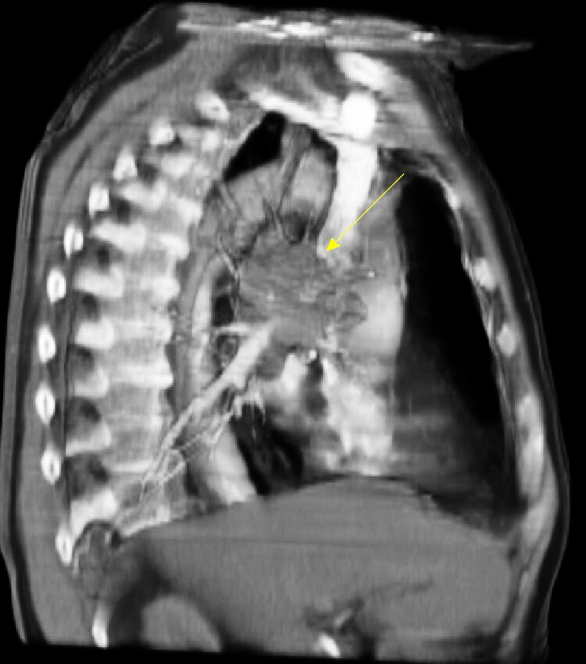
Medical Examples
Lung CT, diagnosis: Bronchial carcinoma in the hilar area (Rendering VolumePro 500, © Hoen-Oh Shin, MH Hannover)

Slide 28
Validation in Medical Visualization
Accuracy of the generated visualizations (for given image data) depends on a variety of parameters:
  Type and parameter of the interpolation
  Distances of the scan points
  Applied gradient filters
  Treatment of edges in case of texture-based procedures
  Implementation errors!

Slide 29
Validation in Medical Visualization
Important accuracy parameters:
  Position error: Distance of an illustrated point (e.g. border between 2 materials) in a visualization
  Normal error: deviation of the approximated normal from the actual normal (angle in degrees)
Evaluation of accuracy:
  Qualitatively via image viewing.
  Problem: No precise solution.
  Quantitatively via volume visualization of phantoms: precise results.
  Problem: Assignability to clinical data.

Slide 30
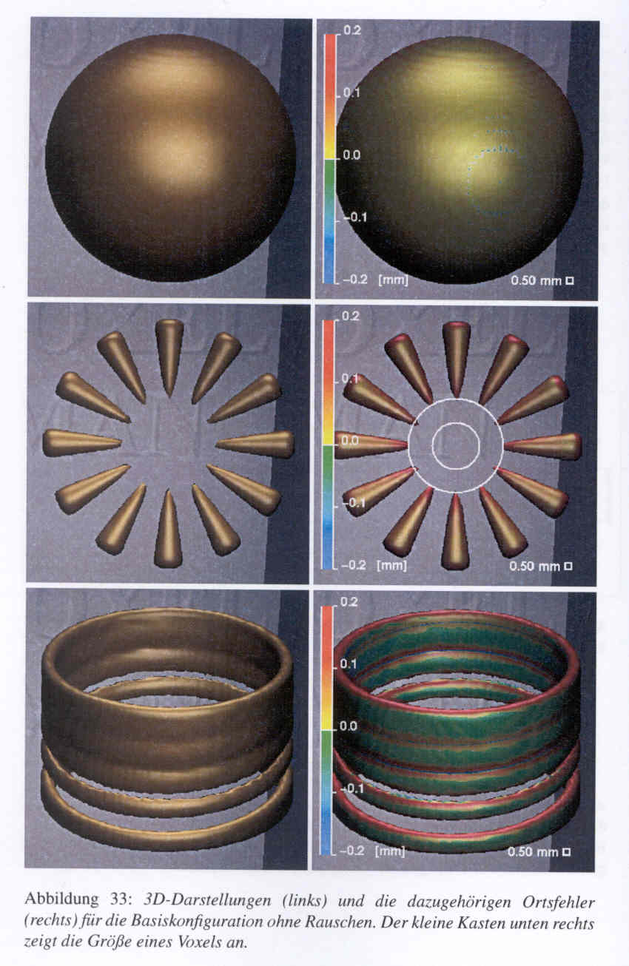
Validation in Medical Visualization
Test body: sphere, SIEMENS star and interrupted cylinder.
Left: Surface visualization. Right: Volume visualization after discretization (1 mm³). Color coding of the arising position error.
© Pommert [2004]

Slide 31
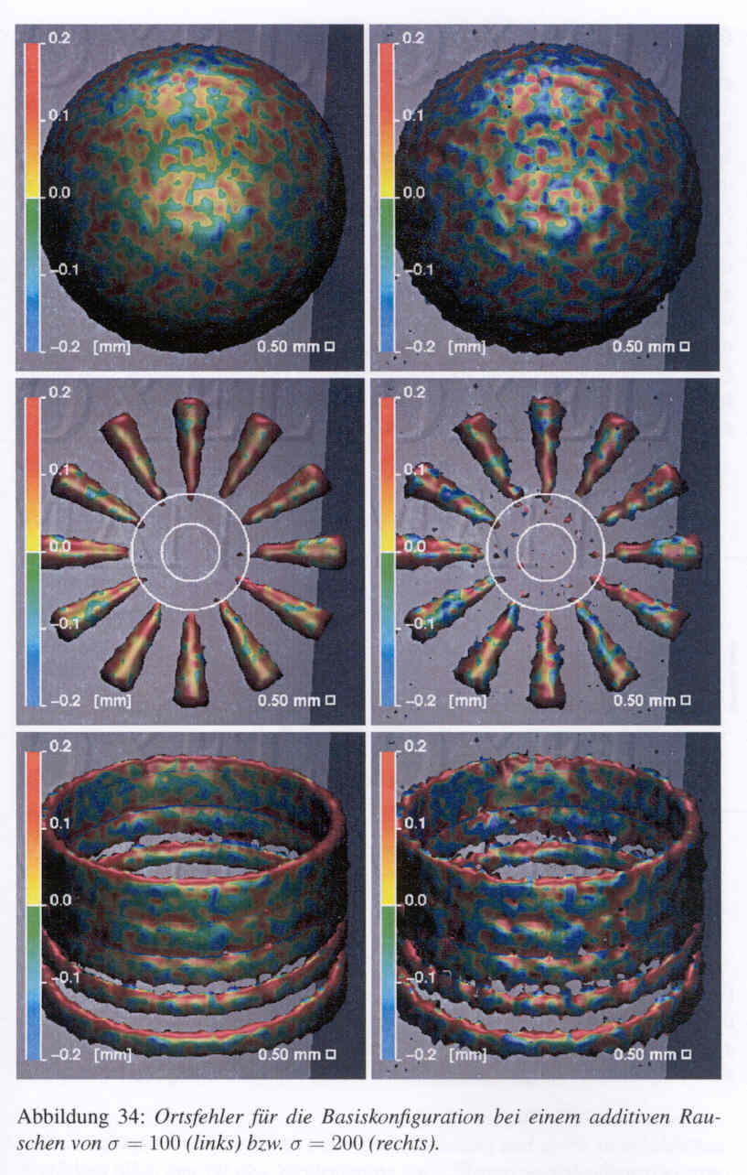
Validation in Medical Visualization
Simulation of additive noise in the image data. Color-coded illustration of the position error.
Interpretation: Which deviations may arise in case of a certain noise level (convolution kernel)?
© Pommert [2004]

Slide 32
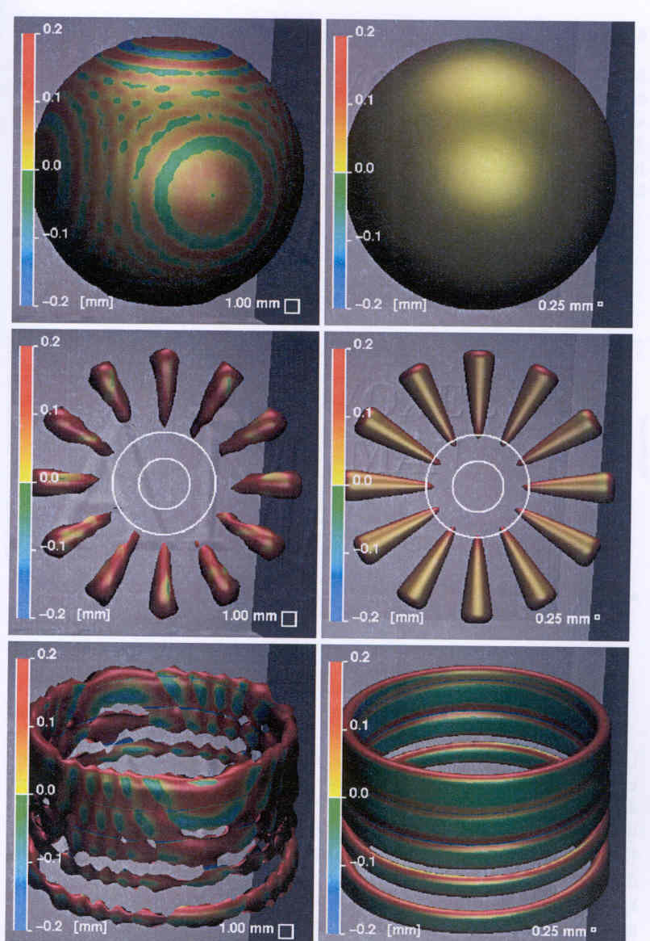
Validation in Medical Visualization
Influence of the voxel size to the errors arising during the visualization.
Interpretation: To assure that the error during the visualization does not exceed <n> mm, I need the following resolution.
© Pommert [2004]

Slide 33
Tools
Vtk (General Electrics, freely available)
Volume Pro (Terarecon, formerly RTVis/Mitsubishi, Link)
Voreen (Linköping, Münster, 2008-2012, Link)
(see Meyer-Spradow, 2009)
VoxLib (Voxar, Edinburgh)
VGL (Volume Graphics, Heidelberg)
VoxelView (Vitrea, Minneapolis)
Analyze and AVW (Mayo Klinik, Rochester, USA)
MevisLab (Fraunhofer MEVIS, Link)

Slide 34
Tools
Comparison criteria:
Quality and efficiency of the rendering
Supported platforms
Integration of DVR, SSD and other rendering procedures
Integration with image processing algorithms
Variety of supported data types
Import and export options (DICOM, VRML)
Documentation and service (WWW, techn. documentation, FAQ, mailing list)
Costs for developer's and run time licenses

Slide 35
Tools: Vtk (General Electrics)
DVR, SSD (iso-surface illustration) and sophisticated algorithms for polygon decimation
Sophisticated class library, integration with Tcl/Tk and Java
Mature concept for annotations (legends, multiline text, coordinate axis labeling, text placement)
Clipping, cutting, data extraction
Volume-preserving smoothing of polygonal surfaces
Pipeline visualization concept
Further Information:
  http://www.kitware.com

Slide 36
Volume Visualization Tools: Volume Pro 500
For a long time, hardware-supported volume rendering needed special and very expensive hardware (Pfister, 1999)
Characteristics:
  Rendering: Shear-warp transformation, MIP, illumination
  Result: Polygon and texture that are depicted by means of a “normal” graphics card
  Capacity: up to 256x256x256 voxels, 12 bit
  Performance: 533 MVoxel/s, ~ 30 Hz
Restrictions:
  Only parallel projection (unsuitable for virtual endoscopy)
  No combination with surface geometries

Slide 37
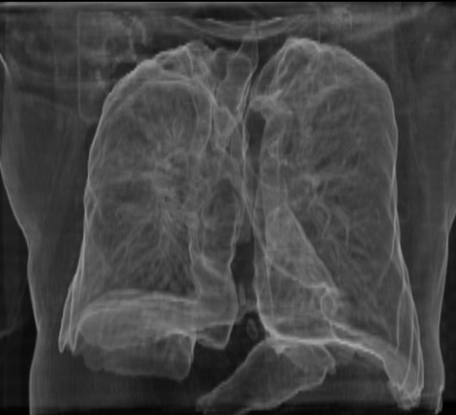
Volume Visualization Tools: Volume Pro 500
Gradient lung shading
(© H. Shin, MH Hannover)

Slide 38
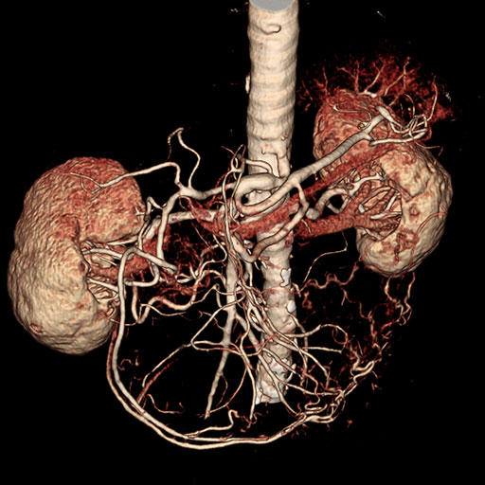
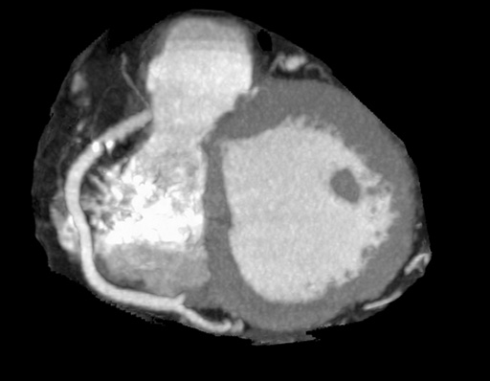
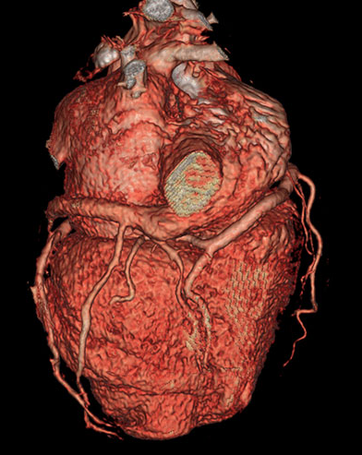
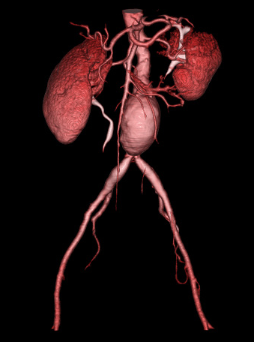
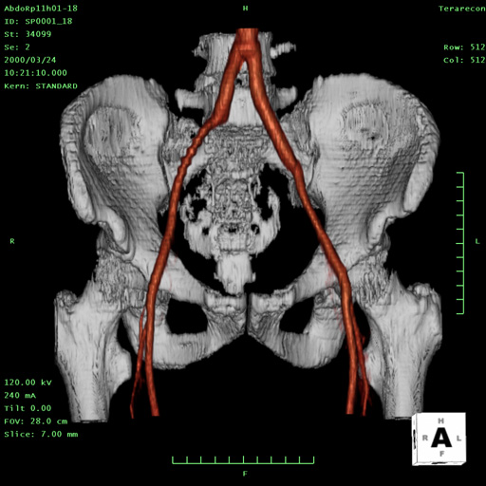
Volume Visualization Tools: Volume Pro 1000 Image Gallery
Volume Pro 1000 was introduced in 2001 by TeraRecon
MIP restricted to a
sub-volume (slab)
Data: Cardiac CTA
CTA of abdominal vessels
Aneurysm of the abdominal aorta

Slide 39
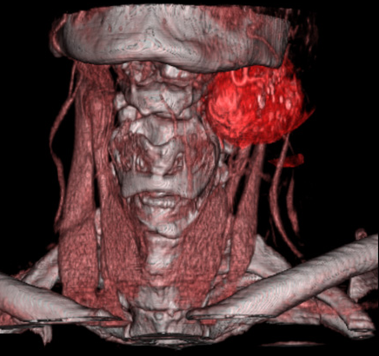
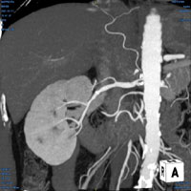
Tools for volume visualization: Volume Pro 1000 image gallery
MIP illustration of the
kidney (vessels)
Tumor in the neck area
See Link for a demo of current webbased volume rendering

Slide 40
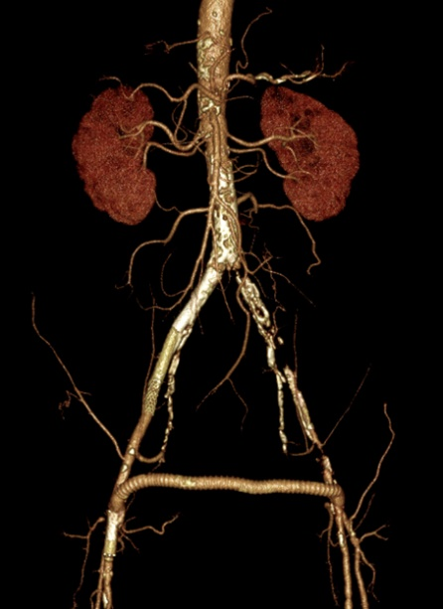
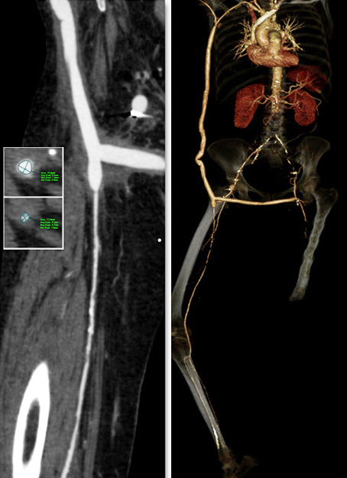
Voxar 3D Core and 3D Advanced
Commercial solutions for clinical applications (Toshiba Medical Visualization Systems, Link)
Provides all techniques discussed so far, also virtual endoscopy, curved MPR
Combined with segmentation and bone removal
Special applications:
Vessel analysis (diagnosis, stent graft planning, see the images)
Cardiac analysis
CT colonography
PET/CT fusion
© Toshiba [2015]

Slide 41
Volume Graphics
Extensive set of functions and rendering techniques for Non-Destructive Testing (analysis and visualization of industrial CT data and CAD models)
Display and analysis of porosity, wall thickness, quantitative analysis and comparison
Non planar 2D views (e.g. unrolled cylinders)
Products: VG Studio, VGStudioMax

Slide 42
Voreen
State-of-the-Art tool for advanced volume rendering
Visual programming approach (rapid prototyping).
Basic GPU raycasting network
All basic functions and a lot of advanced rendering and lightning techniques are provided (Meyer-Spradow, 2009)

Slide 43
Voreen
Glyphs are mapped on an idealized surface of a ventricle. Nodes for glyph placement and rendering are combined with surface extraction and mesh rendering (Meyer-Spradow, 2009).
.

Slide 44
Summary
Rendering of spatial relations via illumination effects: shading, depth cueing, shadow calculation
  Trade-off between interactivity and quality
  Fundamental question: Which techniques are actually relevant for the task?
Tools for volume visualization
  Many freely available tools
  Nowadays, a dedicated graphics card (Nvidia/Ati) is sufficient as hardware

Slide 45
Literature
J. Danskin and P. Hanrahan (1992) “Fast Algorithms for Volume Ray Tracing”, Proc. of Workshop on Volume Visualization, Boston, MA, pp. 91-105
K. Engel, M. Hadwiger, J. Kniss, C. Rezk-Salama, D. Weiskopf. Real-time Volume Graphics, AK Peters, 2006
P. Hastreiter (1999) Registrierung und Visualisierung medizinischer Bild-daten unterschiedlicher Modalitäten, Dissertation, Techn. Fakultät, Universität Erlangen-Nürnberg
K. H. Höhne and R. Bernstein (1986) “Shading 3D-images from CT using gray level gradients”, IEEE Trans. Med. Imaging MI-5, (1986), pp. 45-47
D. Jönsson, E. Sunden, A. Ynnerman, T. Ropinski: A Survey of Volumetric Illumination Techniques for Interactive Volume Rendering. Comput. Graph. Forum 33(1): 27-51 (2014)
A. Kratz, M. Hadwiger, R. Splechtna, A. Fuhrmann, K. Bühler. „GPU-Based High-Quality Volume Rendering For Virtual Environments”, Proc. of Workshop on Augmented Environments for Medical Imaging and Computer Aided Surgery (AMI-ARCS), 2006

Slide 46
Literature
P Lacroute und M Levoy (1994) “Fast Volume Rendering Using a Shear-Warp Factorization of the Viewing Transformation”, Proc. of SIGGRAPH '94, pp. 451-458
P Lacroute (1995) Fast Volume Rendering Using a Shear-Warp Factorization of the Viewing Transformation, PhD-Thesis, Stanford (available online)
D Laur und P Hanrahan (1991) “Hierarchical Splatting: A Progressive Refinement Algorithm for Volume Rendering”, Proc. of SIGGRAPH '91, pp. 285-288
M Levoy (1988) “Display of Surfaces from Volume Data”, IEEE Graphics and Applications, Vol. 8(3):29-37
M Levoy (1990) “Volume Rendering by Adaptive Refinement”, The Visual Computer, Vol.6(1), pp. 2-7, February 1990
M Levoy (1990b) “A Hybrid Raytracer for Rendering Polygon and Volume Data”, IEEE Graphics & Applications, Vol. 10 (2): 33-40
Meyer-Spradow, J.; Ropinski, T.; Mensmann, J.; Hinrichs, K. (2009). "Voreen: A Rapid-Prototyping Environment for Ray-Casting-Based Volume Visualizations," IEEE Computer Graphics and Applications, vol.29 (6): 6-13, 2009
H Noordmans, A Smeulders und H Van der Voort (1997) “Fast Volume Render Techniques for Interactive Analysis”, Visual Computer, Vol. 13(8): 345-358

Slide 47
Literature
J Oikarinen, R Hietala und L Jyrkinen (2000) “High Quality Volume Rendering Using Seed Filling in View Lattice”, In: Chen et al. (2000), pp. 199-210
A Pommert (2004) Simulationsstudien zur Untersuchung der Bildqualität für die 3D-Visualisierung tomografischer Volumendaten, Dissertation am Institut für Mathematik und Datenverarbeitung in der Medizin, Universitätsklinikum Hamburg-Eppendorf
M. Salvi, K. Vidimče, A. Lauritzen, A. Lefohn. 2010. Adaptive volumetric shadow maps. Proc. of Eurographics conference on Rendering (EGSR'10), pp. 1289-1296
SIGGRAPH Course. Advanced Illumination Techniques for GPU-Based Volume Ray-Casting, C. Rezk Salama, M. Hadwiger, T. Ropinski, P. Ljung, Course at ACM SIGGRAPH Asia - 2008
L Westover (1990) “Footprint Evaluation for Volume Rendering”, Proc. of SIGGRAPH '90, pp. 367-376, August 1990
R. Yagel, A. Kaufman, and Q. Zhang (1991) “Realistic Volume Imaging”, IEEE Visualization '91, S. 226-231
R Yagel (1992) “Template-Based Volume Viewing”, Computer Graphics Forum, Vol. 11(3), pp. 153-157
KJ Zuiderveld, AH Koning, M Viergever (1992) “Acceleration of Ray Casting using 3d Distance Transforms”, Proc. of Visualization in Biomedical Computing, pp. 324-335
KJ Zuiderveld (1995) Visualization of multimodality medical volume data using object-oriented methods, PhD-thesis University of Utrecht

